Slide 1
Term Project - Part I
Python Installation &
Deep Learning Environment

Slide 2
Python
In this semester, TAs would recommend using Python which is a programming language to do a term project
Before announcing details about term project, please install and self-learn Python

Slide 3
1. How to install Python ?

Slide 4
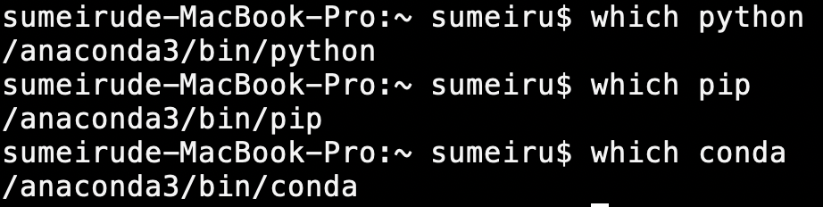
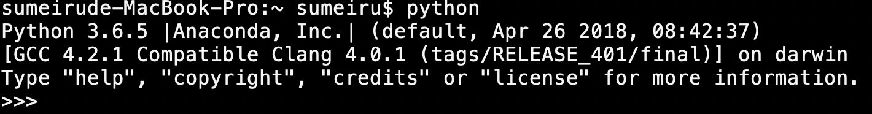
Python Installation
Anaconda
https://www.anaconda.com/distribution/
Test Anaconda Environment
Miniconda
https://docs.conda.io/en/latest/miniconda.html

Slide 5
Command on python
Go to Terminal (Mac/Linux) or Anaconda Prompt (Windows)
Install Package
pip install {package name}
conda install {package name}
Check how many packages you have
pip freeze

Slide 6
Virtual Environment
Develop projects
Manage various needs effectively
Avoid packages version collision

Slide 7
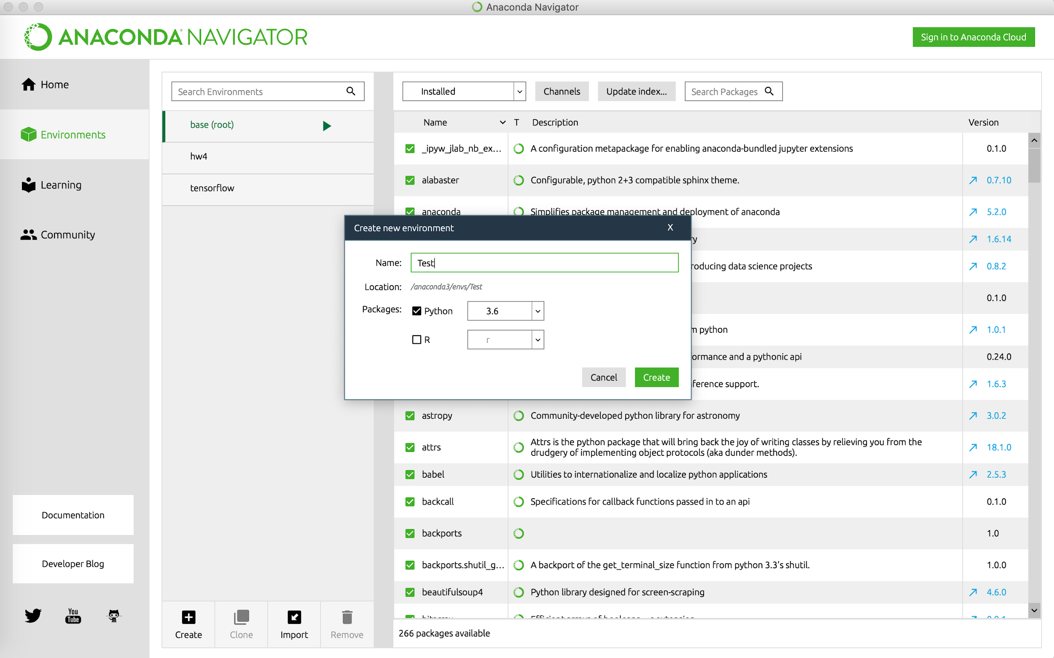

Slide 8
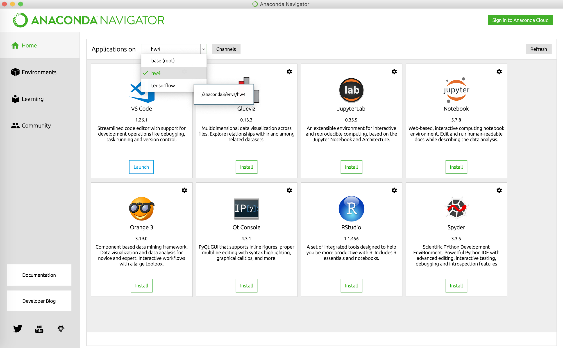
Choose your virtual environment
IDE

Slide 9
2. How to create deep learning environment ?

Slide 10
2-1. If you have your own GPU

Slide 11
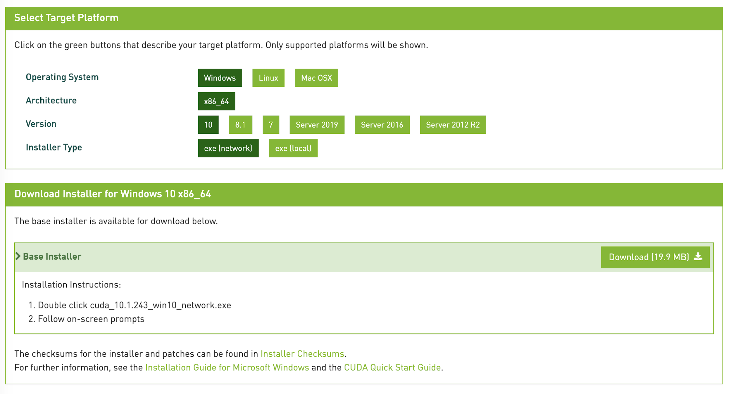
Download Cuda
https://developer.nvidia.com/cuda-downloads

Slide 12
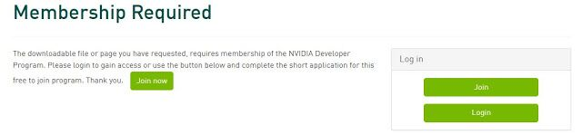
Download Cudnn
https://developer.nvidia.com/cudnn
Register an account

Slide 13
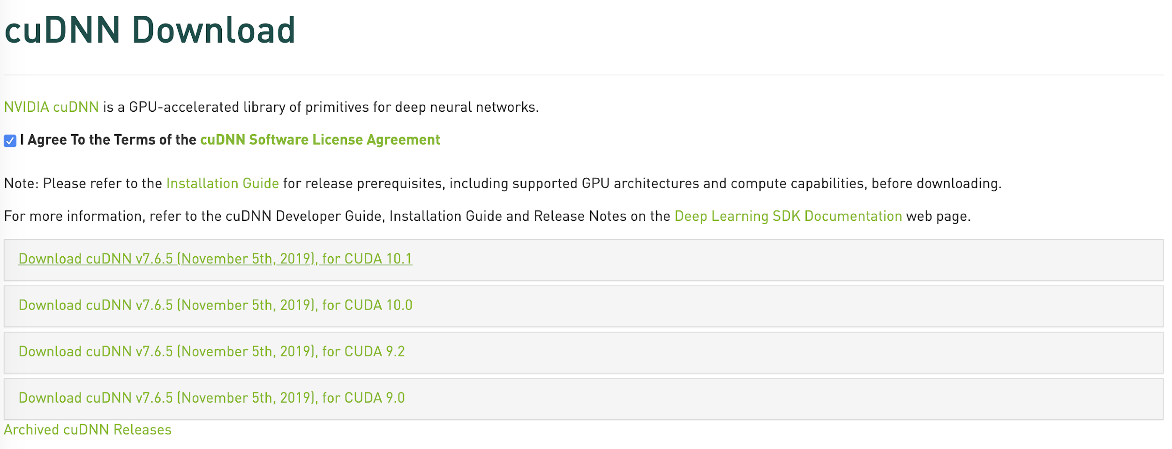
Go to E-mail to activate your account

Slide 14
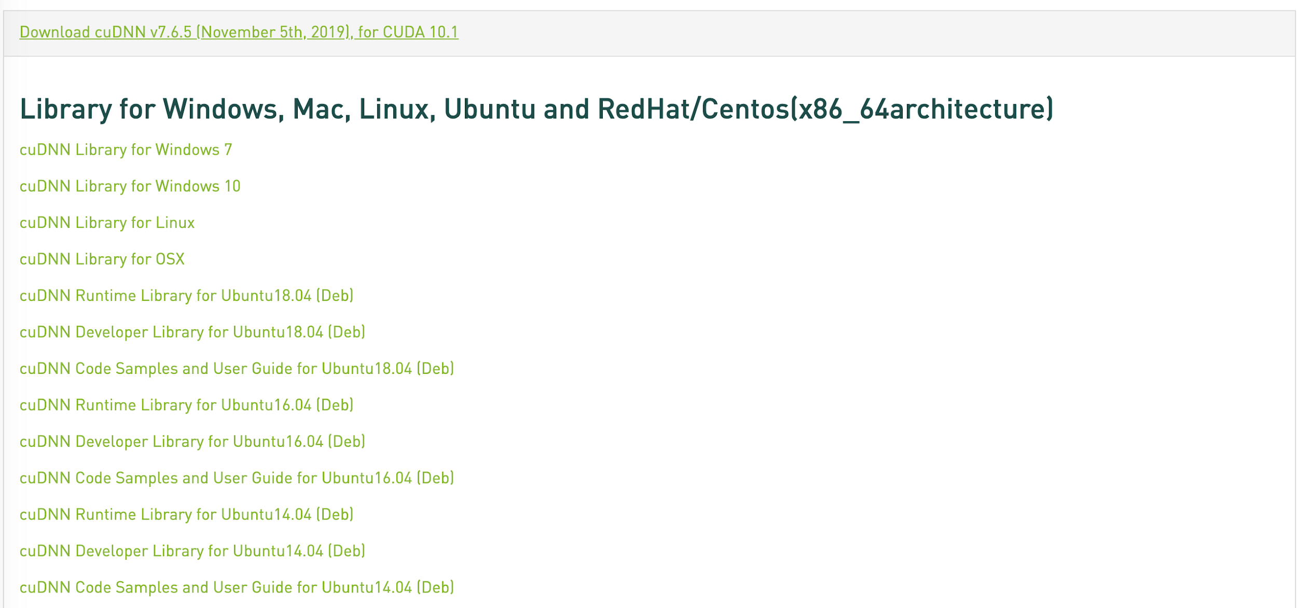
Download cudnn for your CUDA version

Slide 15
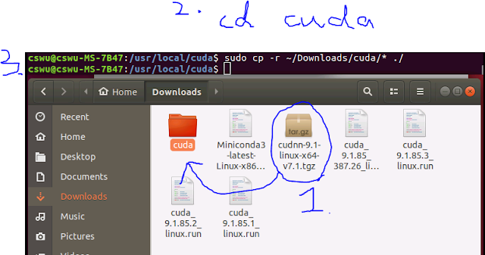
Cudnn
Cudnn is a compressed file
Unzip the Cudnn file
Find the Cuda file (previously downloaded)
Put Cudnn unzipped file into Cuda file

Slide 16



There are a lot of deep learning packages, such as Tensorflow, pytorch, and so on.

Slide 17
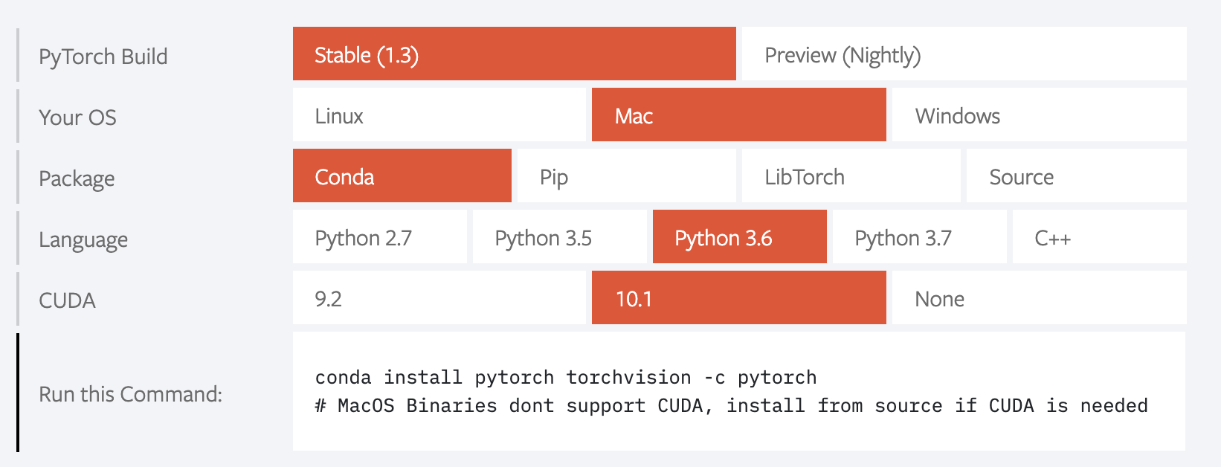
Deep Learning Package - Pytorch
https://pytorch.org/

Slide 18
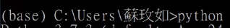
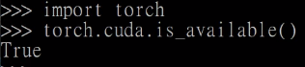
Test Pytorch
Go to your Power Shell / cmd / Terminal
If output is true, it represents your GPU is loaded

Slide 19
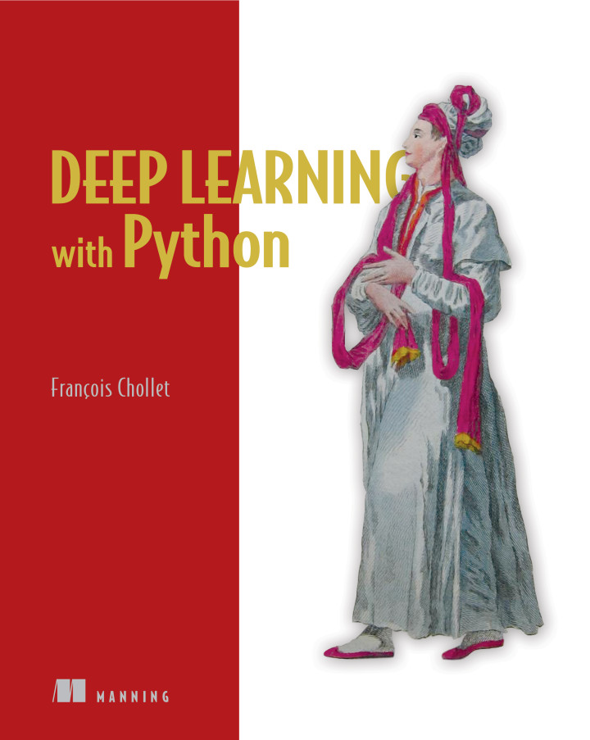
Deep Learning Package - Tensorflow & Keras

Slide 20
You can do your term project from now on

Slide 21
2-2. If you don’t have your own GPU

Slide 22
Google Colab
Login your google drive
Create a new colab file
Right click at empty place, in the menu: More>Colaboratory
If not found this option : More>Connect more apps > search and add Colaboratory

Slide 23
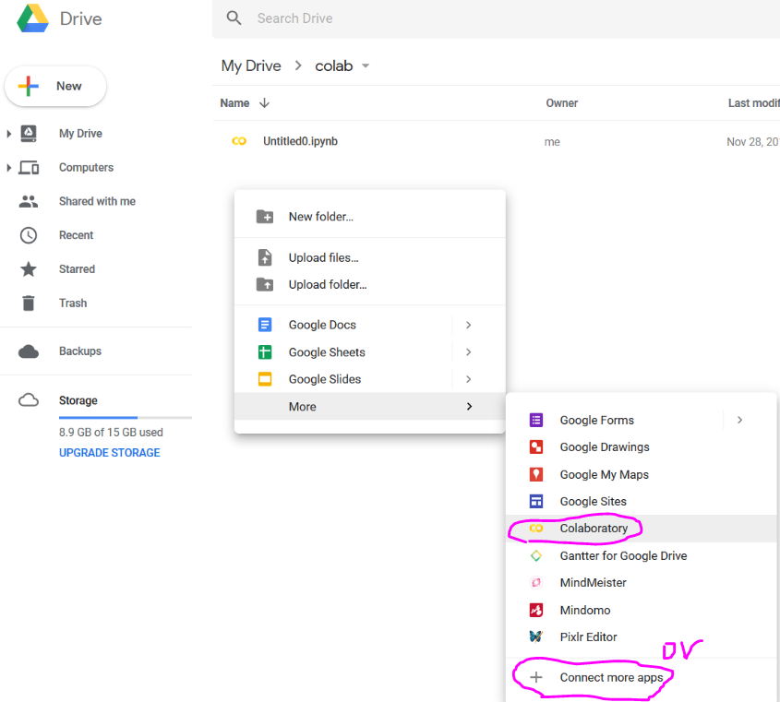

Slide 24
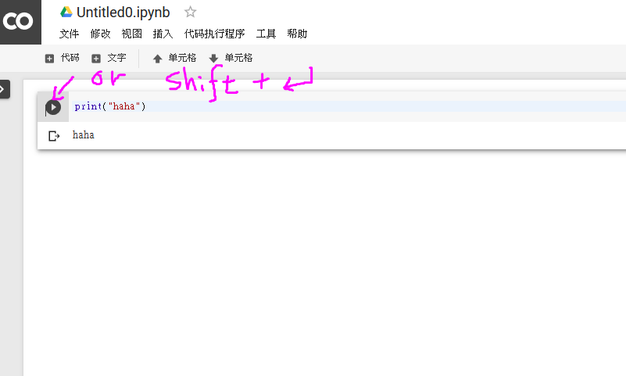
Here you could input some code, then press the play button or shift+enter to execute the code.
You could just consider it as a cloud jupyter notebook with tensorflow in your google drive.

Slide 25
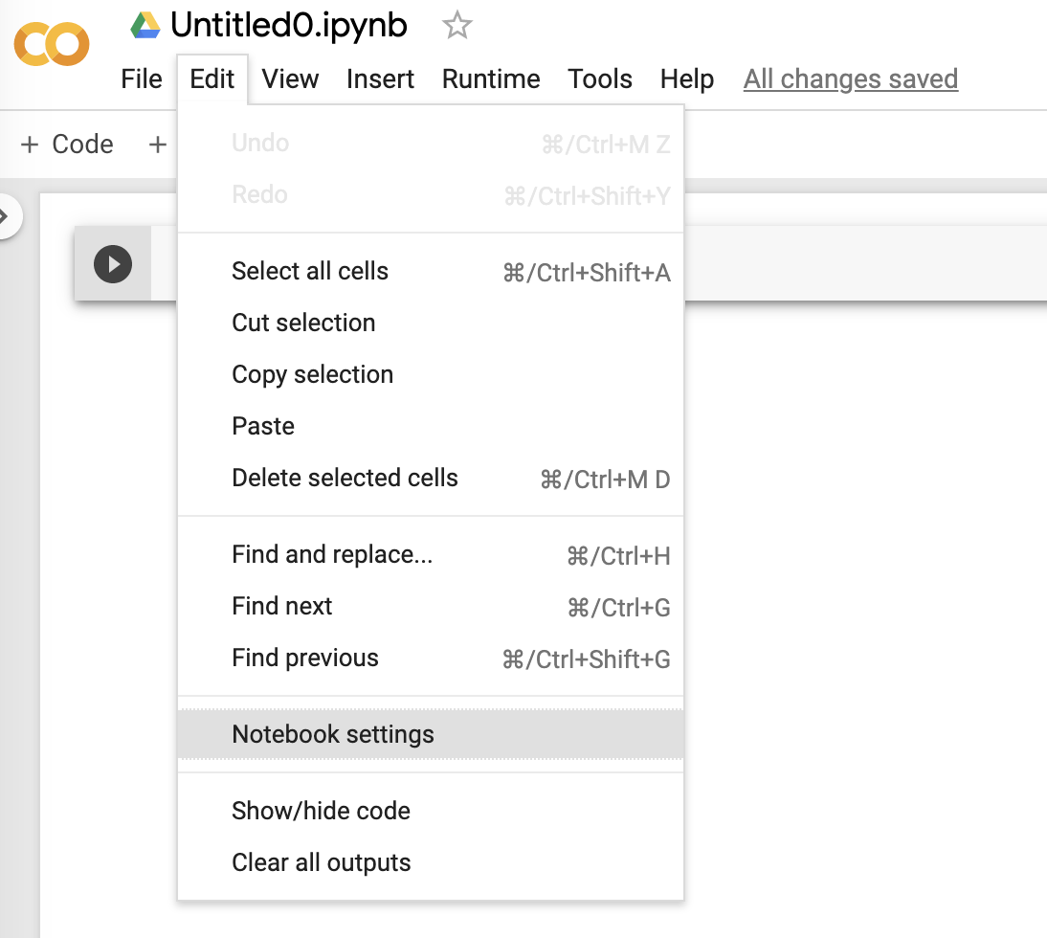
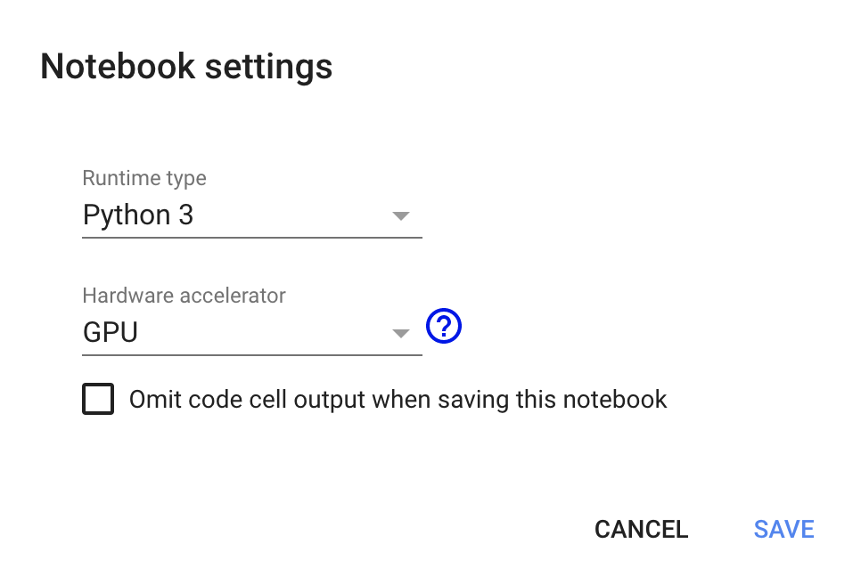
Select GPU to Train Model

Slide 26
Tensorflow Demo on Colab
a good example to let you study how to visualize the result of your model
Copy the test example code from here
This is a simple linear regression model optimized by gradient descent.
2. Paste the code to an empty colab notebook and execute.
Notice that tensorflow, numpy and matplotlib are all pre-installed in colab.

Slide 27
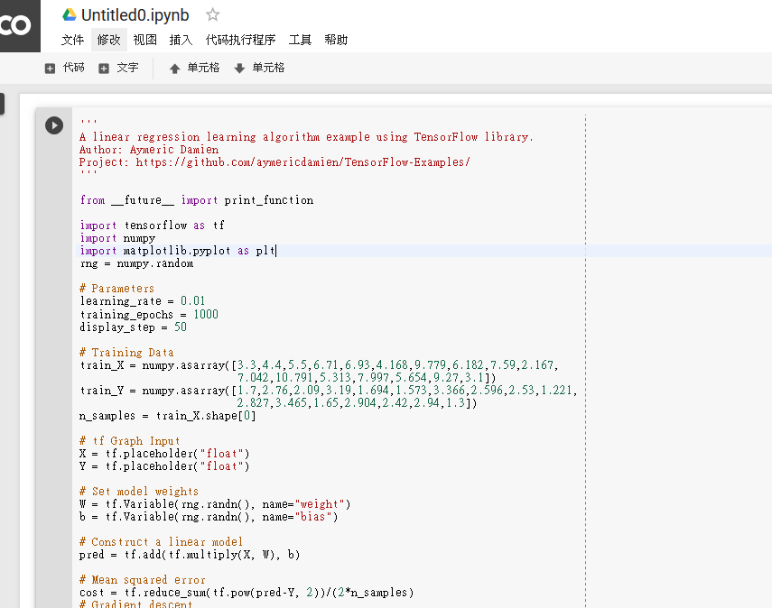

Slide 28
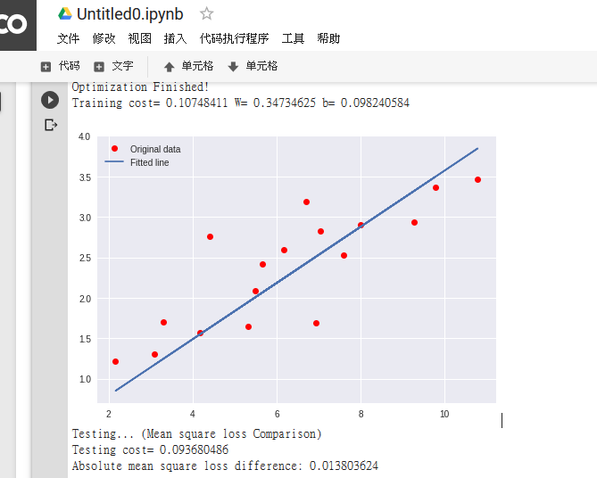
3. The output can be easily show by the plot library: matplotlib

Slide 29
Install Pytorch on Colab
You can use pytorch instead of tensorflow.
1. Import torch directly, then the colab would ask you to install pytorch.
2. Press INSTALL TORCH, then a menu would show up in the left side.
3. Press Insert in the sidemenu, then a new code block would show up
4. Execute the new code block

Slide 30
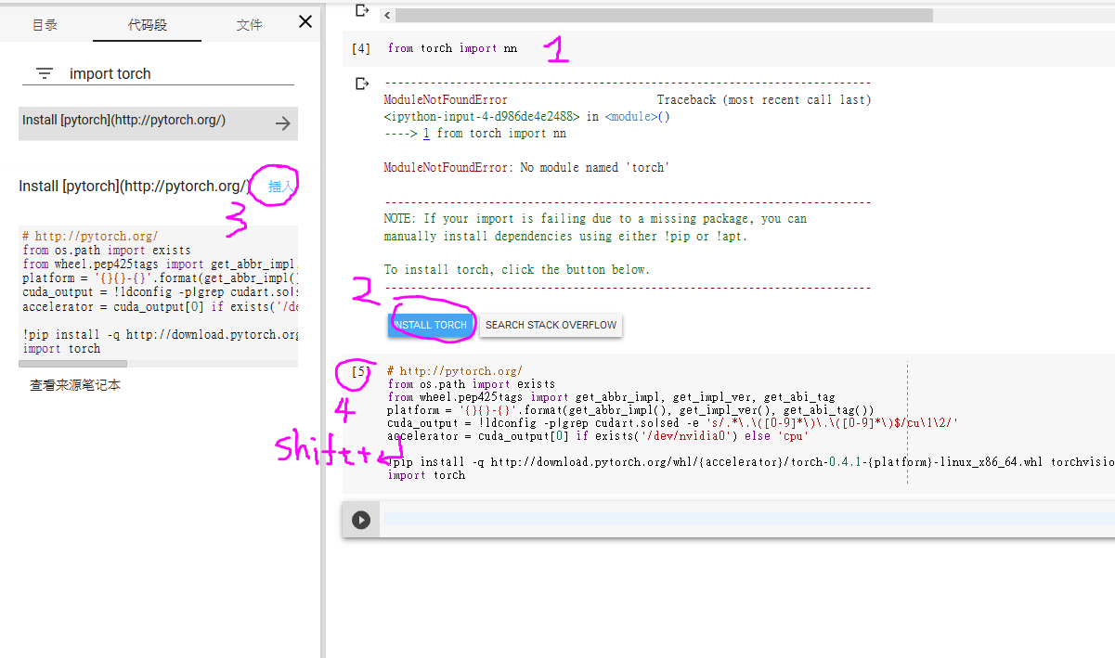

Slide 31
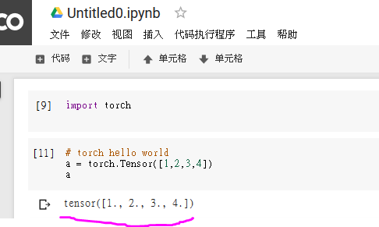
Delete all block then try torch.
If success, “torch hello world” should work

Slide 32
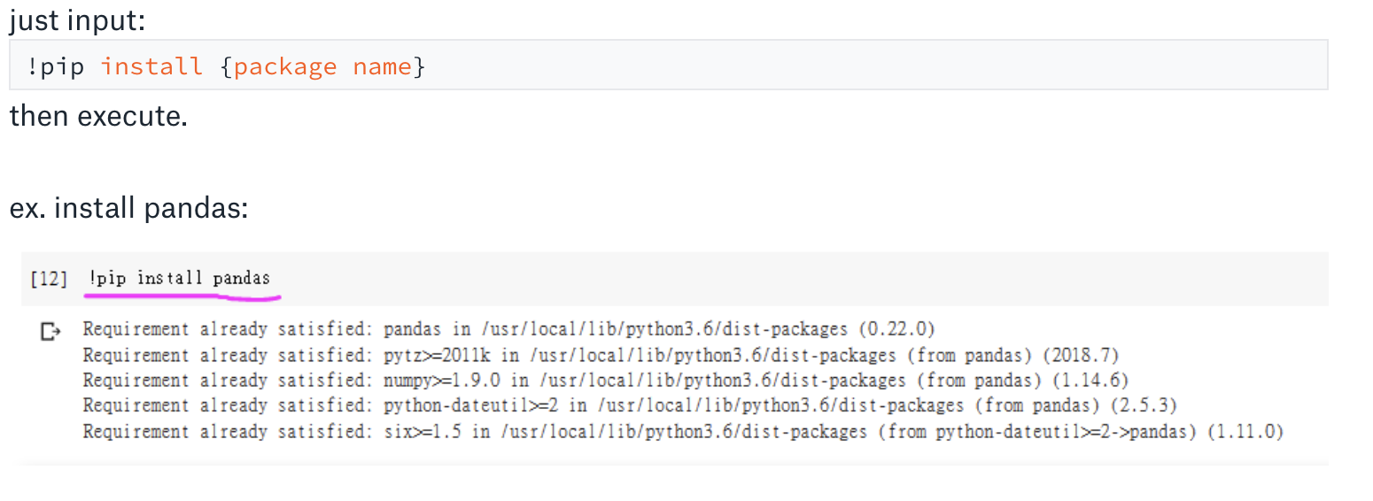
Install other python packages on Colab

Slide 33
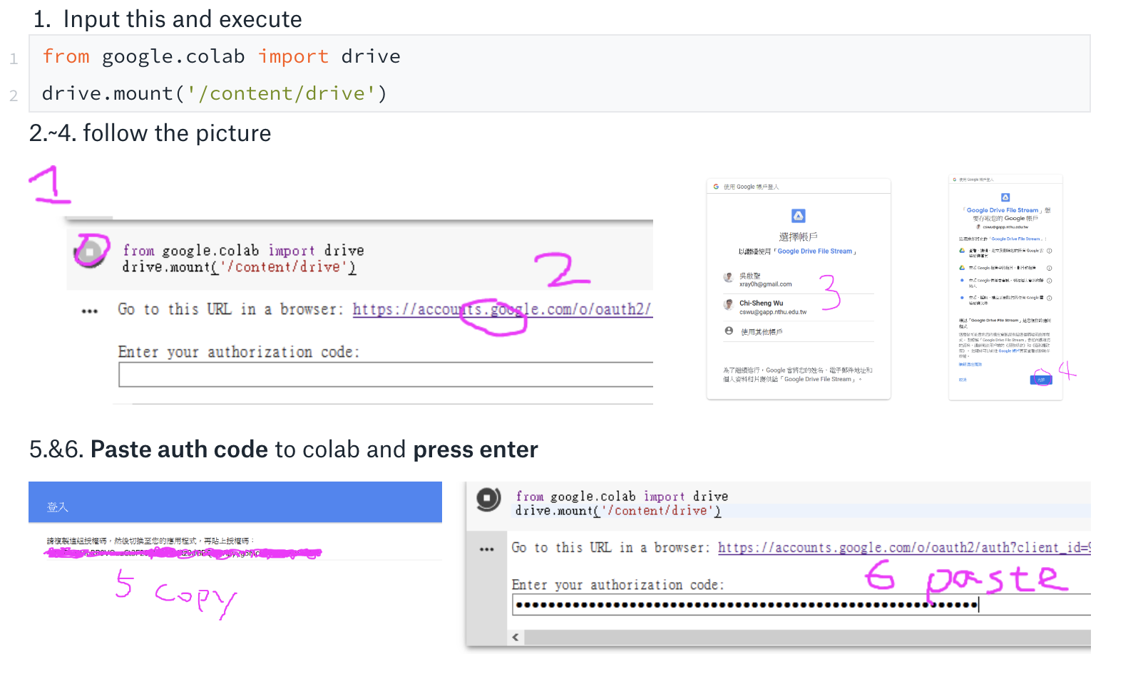
Mount google drive folder to colab

Slide 34
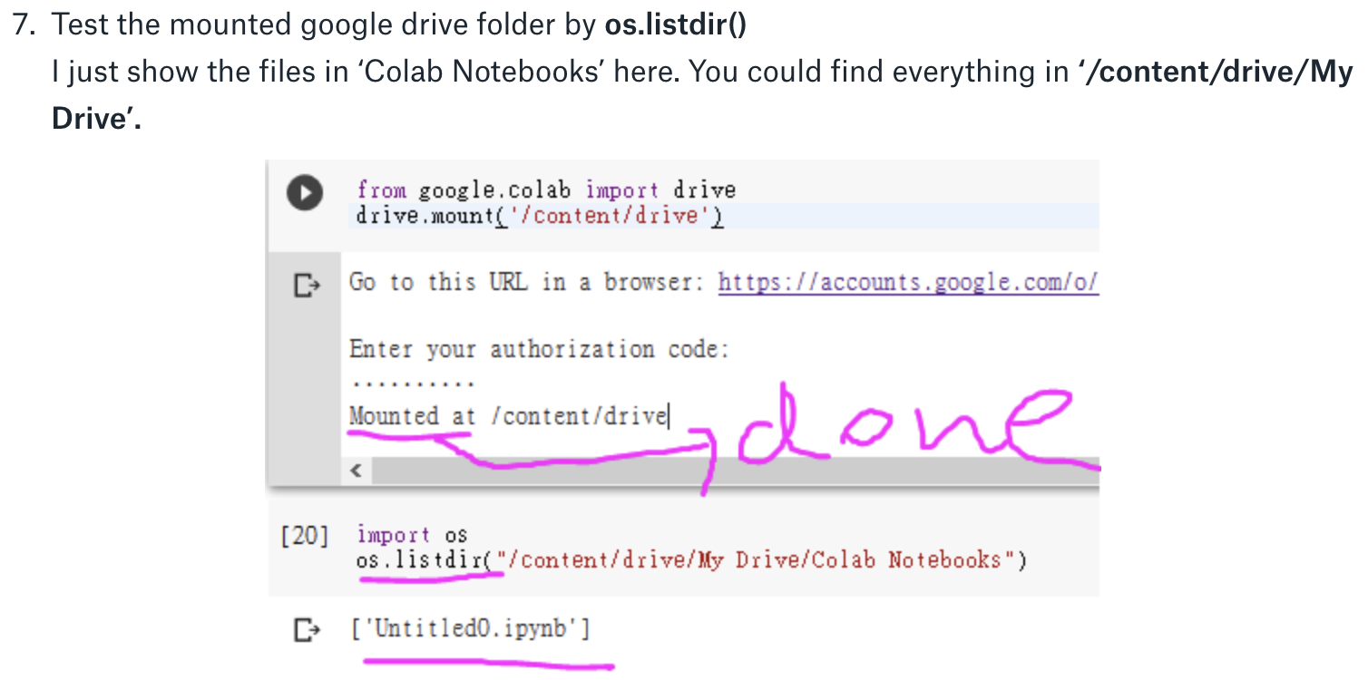

Slide 35
You can do your term project from now on

Slide 36
3. Self-learn Python

Slide 37
Checklist
Make sure that your team could do all jobs in the checklists before TAs announce the term project
https://paper.dropbox.com/doc/practice-of-final-project--AxvG4ZHbneVrAU0O2yZq~zqtAQ-2GNV5YSCyFXTJA96Q7PUS

